Slide 1





1

Slide 2

AGENDA
Overview of the SBRL (25 mins)
Who is the SBRN
Why are we Providing this Product
Product details
Is this product a good fit for me?
Applying (20 mins)
Unique nature of this Program
How to Prepare
Q&A (15 mins)
2

Slide 3


What is the SBRN?
2020
2021
2022
2023
2024
The SBRN was established with 11 partners to support small business/entrepreneurs
SBRN grows from
11 to 30 partners
Identified underlying barriers to conventional lending: complex application processes, credit history, limited financial history or documentation, lack of trust in existing systems, language barriers, and more.
Commerce contracted with GoWest to design and implement a Credit Building Pilot Program
3
Notes:
In 2020, the Small Business Resiliency Network (SBRN) was established to help ensure small businesses and entrepreneurs furthest from opportunity are able to access assistance with COVID relief funding, , loans, and other resources.
Growing from eleven partners in April of 2020 to thirty as of July of 2023, SBRN's trusted community organizations provide culturally and linguistically appropriate outreach, translation, assistance, and education to ensure business owners can receive ongoing support, training, referrals, and services they need from people they trust.
In June of 2023, the Washington Department of Commerce contracted with the GoWest Foundation to design and implement the Credit Building Pilot Program to address underlying barriers to conventional lending identified by SBRN partner organizations.

Slide 4
SBRL PROGRAM OBJECTIVES
FUNDING GAP
Our communities have experienced barriers to accessing business.
This program removes barriers and provides growth opportunities.
BUILDING CREDIT
Low credit scores have hindered folks’ loan access.
This program is a stepping stone to traditional loans, helping businesses build credit history safely.
TRUST & PARTNERSHIPS
Lack of capital, language barriers, and fees create distrust in financial institutions.
We aim to connect businesses with trusted partners (SBRNs) and credit unions, building relationships for future success.
4

Slide 5



PROGRAM OVERVIEW
$500 TO $25K
LOANS
4% INTEREST LOAN
12 to 24 MONTH TERMS
MINIMUM 12 MONTHS
RECEIVE FUNDS EQUAL TO LOAN AMOUNT WHEN LOAN IS PAID OFF
%
+
5

Slide 6
LOAN PROGRAM DETAILS
PRODUCT | DETAILS
Loan Purpose | Loan must be used for a legal business expense
Loan Type | Share-secured loan
Determining Eligibility | Address in eligible area + under 20 FTE
Requirements | To comply with Bank Secrecy Act and Know Your Customer requirements, Name, SSN/ITIN/EIN, and Address are required
Loan Size | At least $500, and up to $25,000
Savings Account | When loan is originated, funds equal to the loan (plus the amount of interest the borrower will pay) will be deposited into the Savings Account; account will be in the borrower’s name, but access will be restricted until the loan is repaid (in a minimum of 12 months)
Interest Rates | Set at 4% .
Repayment Terms | Loan repayment term of between 12 and 24 months; loan repayment period must end before December 31, 2026
Credit Reporting | All payment activity will be reported by credit unions to at least one credit bureau
6

Slide 7
How does successful repayment of this loan benefit a business?
Access to business funding is an important tool for businesses who would like to improve or expand their business.
Businesses aiming to access additional forms of capital in the future, which often require a higher credit score, stand a better chance with an improved credit rating.
Businesses with ties to a financial institution will have documented evidence of their credibility, laying a strong groundwork for future funding pursuits.

Slide 8
UNIQUE NATURE OF ACCESS TO THE SBRL
FOCUSED SUPPORT
The SBRL goes beyond traditional loan programs by addressing specific barriers faced by underserved communities. This includes complex applications, credit history limitations, lack of documentation, language barriers, and a potential distrust of existing financial systems.
PARTNERSHIP-DRIVEN APPROACH
The SBRL leverages the Small Business Resiliency Network (SBRN) and its credit union partners. These trusted organizations can help navigate the application process, build trust with potential borrowers, and ensure the program reaches those who need it most.
BUILDING CREDITWORTHINESS
The SBRL aims for long-term success by offering the Credit Building Pilot Program alongside loans. This empowers borrowers to build or improve their credit history, positioning them for future financial opportunities.
8

Slide 9
BORROWER READINESS
Remember you can always ask your Small Business Resiliency Network partner!
They will have information and be available to make sure you are ready for the SBRL application.
What you can do:
1. Ensure your business meets the SBRL program's size and industry requirements.
2. Collect necessary information/documents to be application ready.

Slide 10

OVERVIEW OF ELIGIBILITY REQUIREMENTS
  Applicants must be entrepreneurs or small businesses negatively affected by the pandemic (Address or Attestation)
  Entrepreneurs/small businesses should have fewer than the equivalent to 20 full-time employees.
  Applicants must possess identification and must have or be in the process of obtaining a federal Uniform Entity Identification (UEI).
  All applicants must apply through an SBRN partner for the completion of the application process.
IMPACT REQUIREMENT
SIZE CRITERIA
IDENTIFICATION DOCUMENTS
COMMUNITY CRITERIA

Slide 11

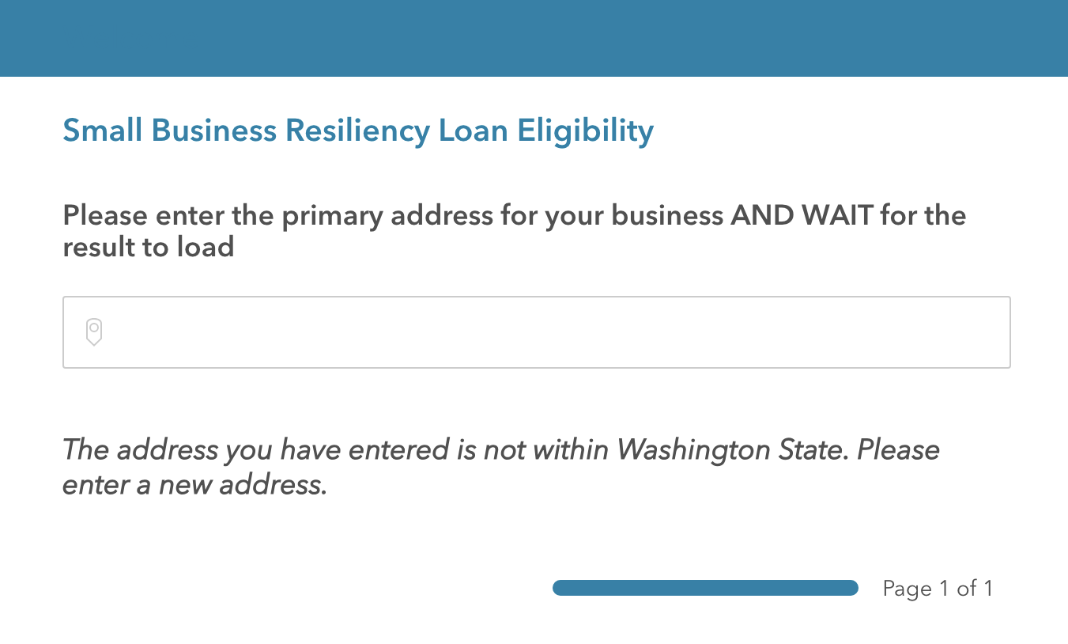
SBRL
PORTAL
Eligibility
Permission
Budget
Worksheet
Application
Preferences &
Demographics
410 Terry Ave N, Seattle 98109 WA

Slide 12
OVERVIEW OF INELIGIBLE BUSINESSES
Businesses suspended or disbarred by the federal government
Licensed Cannabis Operations
Businesses engaged in any socially undesirable activity or activity that may be considered predatory in nature, such as rent-to-own businesses and check cashing businesses
Businesses of a prurient sexual nature (“adult” businesses)
Businesses primarily engaged in political or lobbying activities
Businesses that restrict patronage for any reason other than legal requirements

Slide 13
Q&A
What are your Questions?

Slide 14
